Slide 1
Unit 6 Review Game

Slide 2
The Rules
Goal: To get the most points by collecting cards that add up to 15
Black = Positive numbers
Red = Negative Numbers
Aces are worth 1
Jacks, Queens, and Kings are worth 10
How to Play:
A question and 1 card per group will be put on the board. When each group finishes the problem, they will send their runner to the front to get it checked. If it is correct, they get a card. If it is incorrect, the runner must return to his/her team to solve the problem again. The round cannot end until every group has the correct answer.
Once a group has cards that add up to 15, the runner must bring them up to claim the team’s point.

Slide 3
Question A
Black = Positive numbers; Red = Negative Numbers; Ace = 1; Jack = 10; Queen = 10; King = 10

Slide 4
Answer: Question A
$$\frac{18}{21}=\frac{12}{15}$$
$$\frac{6}{7}=\frac{6}{7}$$
Yes, by SAS
Black = Positive numbers; Red = Negative Numbers; Ace = 1; Jack = 10; Queen = 10; King = 10

Slide 5
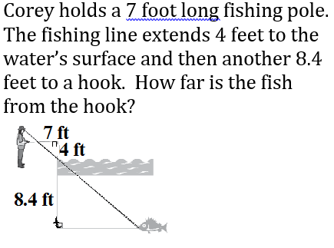
Question B
Black = Positive numbers; Red = Negative Numbers; Ace = 1; Jack = 10; Queen = 10; King = 10

Slide 6
Answer: Question B
14.7 ft
Black = Positive numbers; Red = Negative Numbers; Ace = 1; Jack = 10; Queen = 10; King = 10

Slide 7
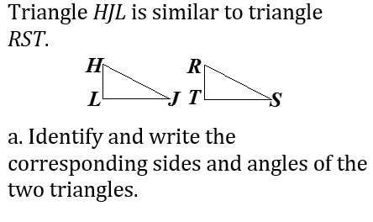
Question C
Black = Positive numbers; Red = Negative Numbers; Ace = 1; Jack = 10; Queen = 10; King = 10

Slide 8
Answer: Question C
$$∠H≅∠R,∠J≅∠S,∠L≅∠T$$
$$\overline{HJ}≅\overline{RS},\overline{JL}≅\overline{ST},\overline{HL}≅\overline{RT}$$
Black = Positive numbers; Red = Negative Numbers; Ace = 1; Jack = 10; Queen = 10; King = 10

Slide 9
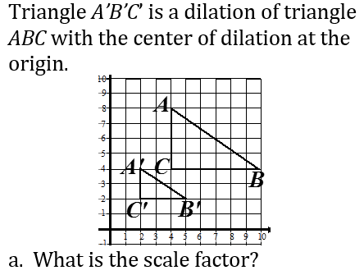
Question D
Black = Positive numbers; Red = Negative Numbers; Ace = 1; Jack = 10; Queen = 10; King = 10

Slide 10
Answer: Question D
$$\frac{1}{2}$$
Black = Positive numbers; Red = Negative Numbers; Ace = 1; Jack = 10; Queen = 10; King = 10

Slide 11
Question E
Black = Positive numbers; Red = Negative Numbers; Ace = 1; Jack = 10; Queen = 10; King = 10

Slide 12
Answer: Question E
5 yd
Black = Positive numbers; Red = Negative Numbers; Ace = 1; Jack = 10; Queen = 10; King = 10

Slide 13
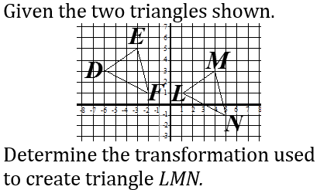
Question F
Black = Positive numbers; Red = Negative Numbers; Ace = 1; Jack = 10; Queen = 10; King = 10

Slide 14
Answer: Question F
Translation
(down 2, right 7)
Black = Positive numbers; Red = Negative Numbers; Ace = 1; Jack = 10; Queen = 10; King = 10

Slide 15
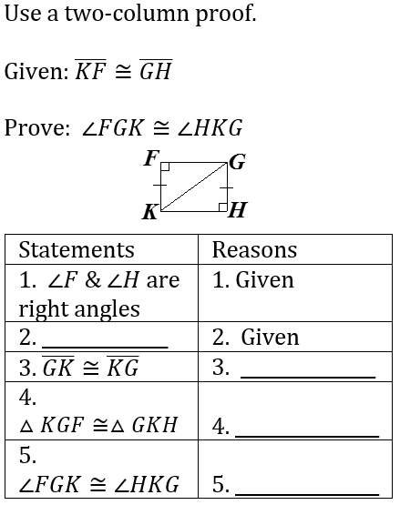
Question G
Black = Positive numbers; Red = Negative Numbers; Ace = 1; Jack = 10; Queen = 10; King = 10

Slide 16
Answer: Question G
2. $\overline{KF}≅\overline{GH}$
Reflexive Prop. Congruence
7. HL
8. CPCTC
Black = Positive numbers; Red = Negative Numbers; Ace = 1; Jack = 10; Queen = 10; King = 10

Slide 17
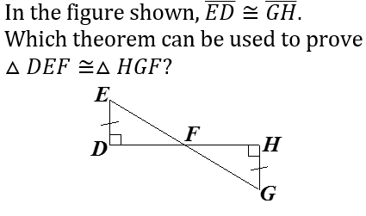
Question H
Black = Positive numbers; Red = Negative Numbers; Ace = 1; Jack = 10; Queen = 10; King = 10

Slide 18
Answer: Question H
AAS
Black = Positive numbers; Red = Negative Numbers; Ace = 1; Jack = 10; Queen = 10; King = 10

Slide 19
Question I
Black = Positive numbers; Red = Negative Numbers; Ace = 1; Jack = 10; Queen = 10; King = 10

Slide 20
Answer: Question I
ASA
or
AAS
(depending on your chosen angles)
Black = Positive numbers; Red = Negative Numbers; Ace = 1; Jack = 10; Queen = 10; King = 10

Slide 21
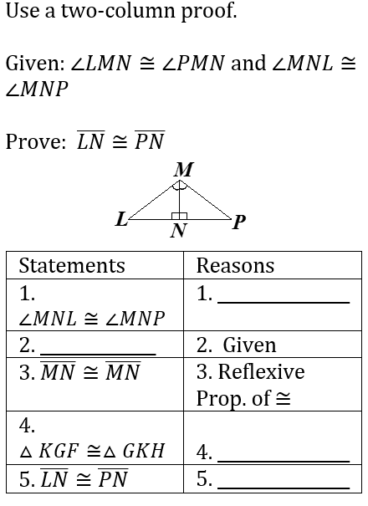
Question J
Black = Positive numbers; Red = Negative Numbers; Ace = 1; Jack = 10; Queen = 10; King = 10

Slide 22
Answer: Question J
Given
2. $∠LMN≅∠PMN$
ASA
5. CPCTC
Black = Positive numbers; Red = Negative Numbers; Ace = 1; Jack = 10; Queen = 10; King = 10

Slide 23
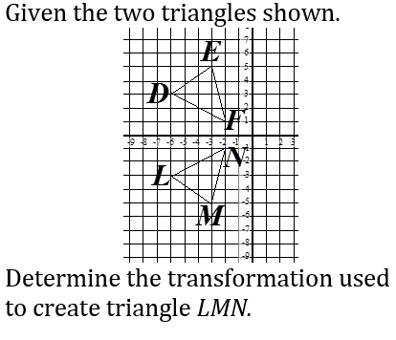
Question K
Black = Positive numbers; Red = Negative Numbers; Ace = 1; Jack = 10; Queen = 10; King = 10

Slide 24
Answer: Question K
Reflection over the x-axis
Black = Positive numbers; Red = Negative Numbers; Ace = 1; Jack = 10; Queen = 10; King = 10

Slide 25
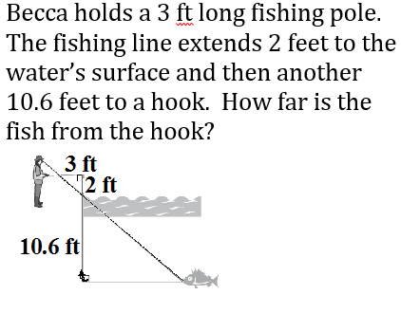
Question L
Black = Positive numbers; Red = Negative Numbers; Ace = 1; Jack = 10; Queen = 10; King = 10

Slide 26
Answer: Question L
15.9 ft
Black = Positive numbers; Red = Negative Numbers; Ace = 1; Jack = 10; Queen = 10; King = 10

Slide 27
Question M
Black = Positive numbers; Red = Negative Numbers; Ace = 1; Jack = 10; Queen = 10; King = 10

Slide 28
Answer: Question M
HL
Black = Positive numbers; Red = Negative Numbers; Ace = 1; Jack = 10; Queen = 10; King = 10

Slide 29
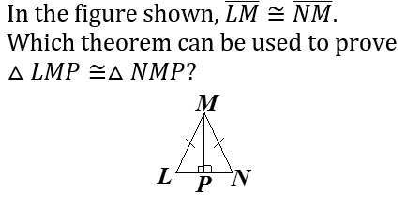
Question N
Black = Positive numbers; Red = Negative Numbers; Ace = 1; Jack = 10; Queen = 10; King = 10

Slide 30
Answer: Question N
HL
Black = Positive numbers; Red = Negative Numbers; Ace = 1; Jack = 10; Queen = 10; King = 10

Slide 31
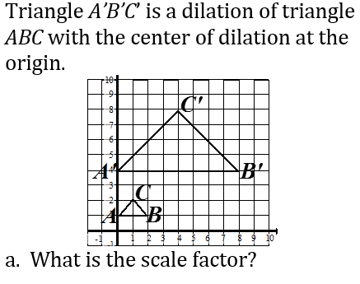
Question O
Black = Positive numbers; Red = Negative Numbers; Ace = 1; Jack = 10; Queen = 10; King = 10

Slide 32
Answer: Question O
54˚ & 144˚
Black = Positive numbers; Red = Negative Numbers; Ace = 1; Jack = 10; Queen = 10; King = 10

Slide 33
Question P
Julie bisects angle KLM. She labels a point on the bisector as N. Angle KLN is 37˚. What is the measure of angle KLM?
Black = Positive numbers; Red = Negative Numbers; Ace = 1; Jack = 10; Queen = 10; King = 10

Slide 34
Answer: Question P
$$\frac{4}{1}$$
Black = Positive numbers; Red = Negative Numbers; Ace = 1; Jack = 10; Queen = 10; King = 10

Slide 35
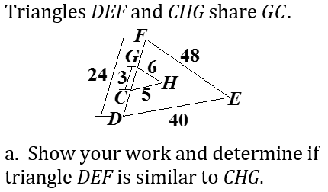
Question Q
Black = Positive numbers; Red = Negative Numbers; Ace = 1; Jack = 10; Queen = 10; King = 10

Slide 36
Answer: Question Q
$$\frac{3}{24}=\frac{6}{48}=\frac{5}{40}$$
$$\frac{1}{8}=\frac{1}{8}=\frac{1}{8}$$
Yes, by SSS
Black = Positive numbers; Red = Negative Numbers; Ace = 1; Jack = 10; Queen = 10; King = 10

Slide 37
Question R
Black = Positive numbers; Red = Negative Numbers; Ace = 1; Jack = 10; Queen = 10; King = 10

Slide 38
Answer: Question R
42 ft
Black = Positive numbers; Red = Negative Numbers; Ace = 1; Jack = 10; Queen = 10; King = 10

Slide 39
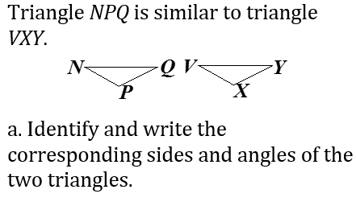
Question S
Black = Positive numbers; Red = Negative Numbers; Ace = 1; Jack = 10; Queen = 10; King = 10

Slide 40
Answer: Question S
$$∠N≅∠V,∠P≅∠X,∠Q≅∠Y$$
$$\overline{NP}≅\overline{VX},\overline{PQ}≅\overline{XY},\overline{NQ}≅\overline{VY}$$
Black = Positive numbers; Red = Negative Numbers; Ace = 1; Jack = 10; Queen = 10; King = 10

Slide 41
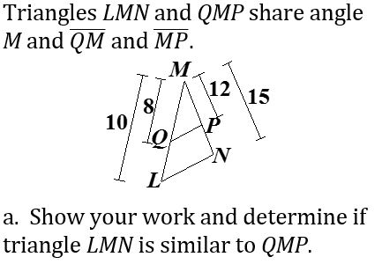
Question T
Black = Positive numbers; Red = Negative Numbers; Ace = 1; Jack = 10; Queen = 10; King = 10

Slide 42
Answer: Question T
$$\frac{8}{10}=\frac{12}{15}$$
$$\frac{4}{5}=\frac{4}{5}$$
Yes, by SAS
Black = Positive numbers; Red = Negative Numbers; Ace = 1; Jack = 10; Queen = 10; King = 10

Slide 43
Question U
Black = Positive numbers; Red = Negative Numbers; Ace = 1; Jack = 10; Queen = 10; King = 10

Slide 44
Answer: Question U
24 ft
Black = Positive numbers; Red = Negative Numbers; Ace = 1; Jack = 10; Queen = 10; King = 10

Slide 45
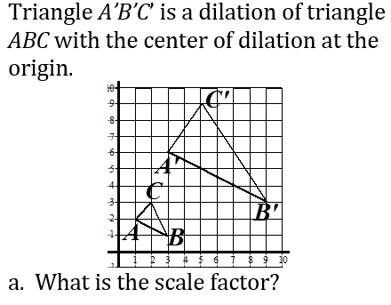
Question V
Black = Positive numbers; Red = Negative Numbers; Ace = 1; Jack = 10; Queen = 10; King = 10

Slide 46
Answer: Question V
$$\frac{3}{1}$$
Black = Positive numbers; Red = Negative Numbers; Ace = 1; Jack = 10; Queen = 10; King = 10

Slide 47
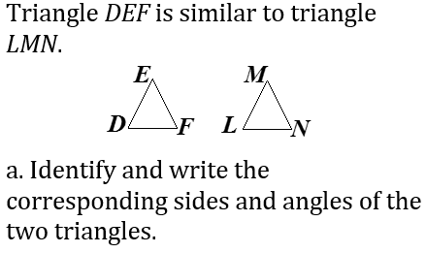
Question W
Black = Positive numbers; Red = Negative Numbers; Ace = 1; Jack = 10; Queen = 10; King = 10

Slide 48
Answer: Question W
$$∠D≅∠L,∠E≅∠M,∠F≅∠N$$
$$\overline{DE}≅\overline{LM},\overline{EF}≅\overline{MN},\overline{DF}≅\overline{LN}$$
Black = Positive numbers; Red = Negative Numbers; Ace = 1; Jack = 10; Queen = 10; King = 10

Slide 49
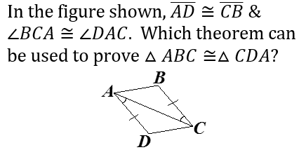
Question X
Black = Positive numbers; Red = Negative Numbers; Ace = 1; Jack = 10; Queen = 10; King = 10

Slide 50
Answer: Question X
SAS
Black = Positive numbers; Red = Negative Numbers; Ace = 1; Jack = 10; Queen = 10; King = 10

Slide 51
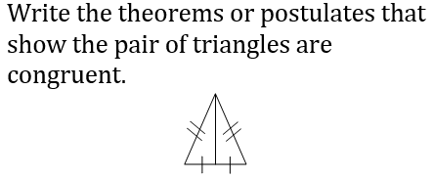
Question Y
Black = Positive numbers; Red = Negative Numbers; Ace = 1; Jack = 10; Queen = 10; King = 10

Slide 52
Answer: Question Y
SSS
Black = Positive numbers; Red = Negative Numbers; Ace = 1; Jack = 10; Queen = 10; King = 10

Slide 53
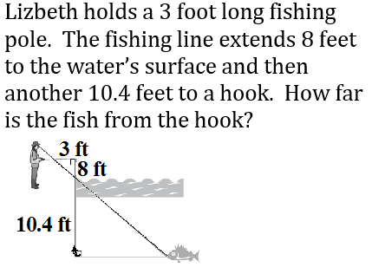
Question Z
Black = Positive numbers; Red = Negative Numbers; Ace = 1; Jack = 10; Queen = 10; King = 10

Slide 54
Answer: Question Z
3.9 ft
Black = Positive numbers; Red = Negative Numbers; Ace = 1; Jack = 10; Queen = 10; King = 10

Slide 55
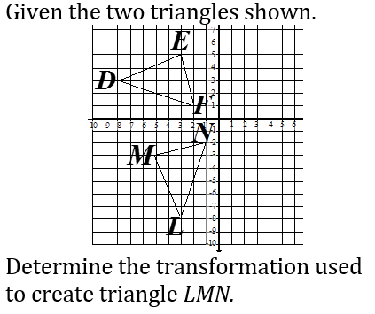
Question AA
Black = Positive numbers; Red = Negative Numbers; Ace = 1; Jack = 10; Queen = 10; King = 10

Slide 56
Answer: Question AA
270 degree rotation
Black = Positive numbers; Red = Negative Numbers; Ace = 1; Jack = 10; Queen = 10; King = 10

Slide 57
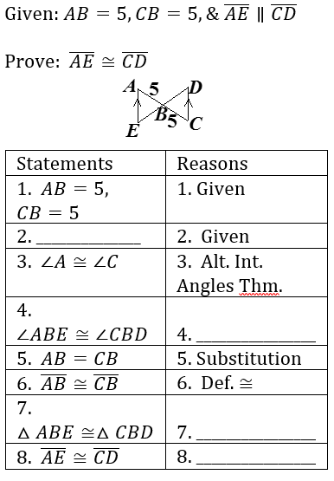
Question AB
Black = Positive numbers; Red = Negative Numbers; Ace = 1; Jack = 10; Queen = 10; King = 10

Slide 58
Answer: Question AB
2. $\overline{AE}∥\overline{CD}$
Vertical Angles Theorem
7. ASA
8. CPCTC
Black = Positive numbers; Red = Negative Numbers; Ace = 1; Jack = 10; Queen = 10; King = 10

